Slide 1
Cryptographic Protocol Analysis and Verification
Members:
Juhi Patel Kunal Mangalorekar
Lizabeth Trevino
Nidhi Jawandhia

Slide 2
Overview
Introduction to Cryptographic Protocols
Introduction to CPSA and Dolev-Yao model
Introduction to 5G Authentication
Working of 5G EAP-TLS
Future Research/Plans

Slide 3
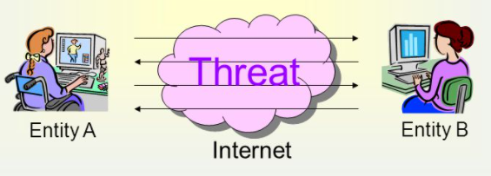
Introduction to Cryptographic Protocols
A set of rules that are designed to allow secure communication over an untrusted network such as the internet.
  No face-to-face interaction
  No way of knowing who you are talking to
Attackers can wreak havoc without proper cryptographic protocols in place.
  Man-in-the-middle, spoofing, etc.
Tools used in cryptographic protocols:
  Keys, authentications, encryptions, etc.
How do we know protocols are secure?

Slide 4
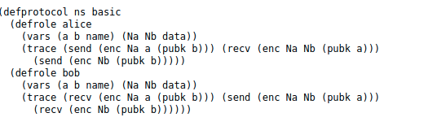
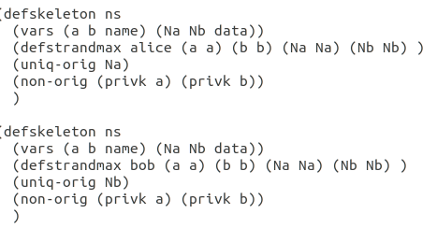
Introduction to CPSA (Cryptographic Protocol Shapes Analyzer)
Designed to assist in the design and analysis cryptographic protocols
Analysis is performed within a Dolev-Yao model
Input: Protocol definition and an execution skeleton(.lsp or .scm)

Slide 5
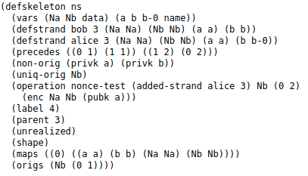
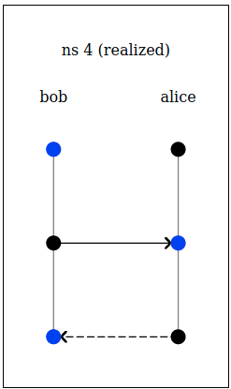
Introduction to CPSA (Cryptographic Protocol Shapes Analyzer)
Output: Runs all possible executions based on the description with the presence of the Dolev-Yao adversary (.xhtml)
Each enumeration is called a ‘shape’ of the protocol
CPSA is aimed to reveal only structural flaws in the protocol

Slide 6
Dolev-Yao model
Network:
Set of machines which can send/receive messages
Adversary assumed to be part of the network
Adversary:
Sniff, filter, intercept and modify any messages on the network.
Only limited by constraints of the cryptographic protocol used.

Slide 7
Introduction to 5G Authentication
Cellular Network technologies evolved over a period of time from 2G, 3G, 4G and now 3GPP is developing 5G.
Studies showed some catch in previous generation-
Lack of network authentication in 2G.
Lack of integration protection and confidentiality in certain signalling messages.
To mitigate these issues 3GPP defines an Authentication and Key Agreement protocol which is a challenge and response authentication protocol based on a symmetric key shared between subscriber and home network.

Slide 8
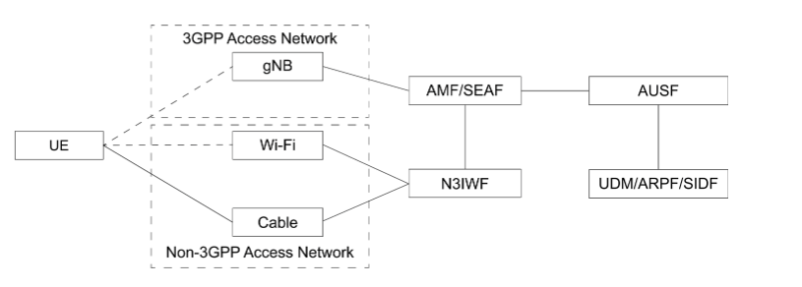
5G Authentication is designed in a manner that it is both open(support of Extensible Authentication protocol) and access network agnostic(network supporting 3GPP and for network not supporting 3GPP like wifi and cables).
Several security contexts can be established with one authentication execution, which allows the UE to move from a 3GPP access network to a non 3GPP network without reauthentication.

Slide 9
Working of the 5G EAP-TLS
EAP-TLS is defined in 5G subscriber authentication in limited use cases such as private networks and IOT environment.
When selected as authentication protocol, it is performed between the UE(EAP peer) and AUSF(EAP server) through Security Anchor Function(EAP pass through authenticator) by forwarding EAP-TLS messages back and forth.
Mutual Authentication is accomplished by verifying either each others certificate or pre shared key established during hand shaking.
At the end a key is derives and the first 256 bits is used to derive the other subsequent keys.

Slide 10
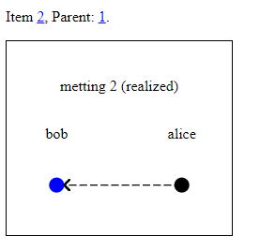
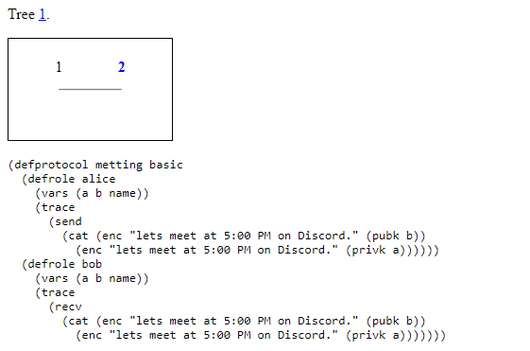
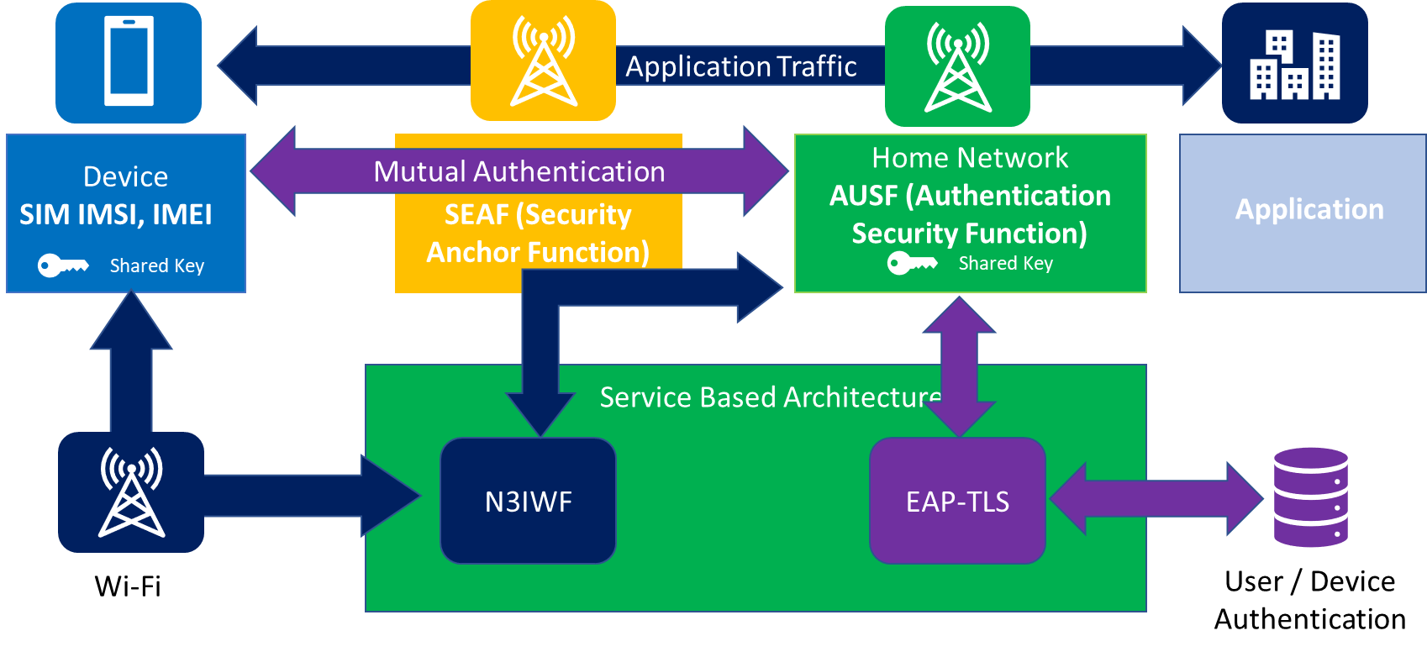
Future Research/Plans
Independent research of the 5G EAP Protocol
  Reading research papers,
  Looking at past research documentation from the previous group
Cryptographic Protocol Shapes Analyzer (CPSA) Training
  7-week seminar to learn the concepts behind CPSA (Dolev-Yao Adversary)
  Practical training on the language used for the creation of models that will be run through CPSA
  Learning to understand the meaning of the shapes and what they imply about the structural properties of a protocol.
[1]

Slide 11
References
[1] A.T. Sherman, E. Lanus, M. Liskov, E. Zieglar, R. Chang, E. Golaszewski, R. Wnuk-Fink, C.J. Bonyadi, M. Yaksetig, and I. Blumenfeld, “Formal Methods Analysis of the Secure Remote Password Protocol,” Cyber Defense Lab, University of Maryland, Baltimore, MD, USA, 2020. Accessed: Feb. 9, 2021. [Online]. Available: https://arxiv.org/abs/2003.07421
[2] Doghmi, Shaddin F., et al. “Searching for Shapes in Cryptographic Protocols.” Tools and Algorithms for the Construction and Analysis of Systems, pp. 523–537., doi:10.1007/978-3-540-71209-1_41.
[3] J. Zhang, L. Yang, W. Cao and Q. Wang, "Formal Analysis of 5G EAP-TLS Authentication Protocol Using Proverif," in IEEE Access, vol. 8, pp. 23674-23688, 2020, doi: 10.1109/ACCESS.2020.2969474.
[4] Ramsdell, John D., Joshua D. Guttman, Jonathan K. Millen, and Brian O'Hanlon. "An analysis of the CAVES attestation protocol using CPSA." arXiv preprint arXiv:1207.0418 (2012).
[5] Lucca Hirschi, Ralf Sasse, Jannik Dreier. Security Issues in the 5G Standard and How Formal Methods Come to the Rescue. ERCIM News, ERCIM, 2019. Hal-02268822
[6] Liskov, M. D., Ramsdell, J. D., Guttman, J. D., & Rowe, P. D. (2016). The Cryptographic Protocol Shapes Analyzer: A Manual. The MITRE Corporation.

